Slide 1
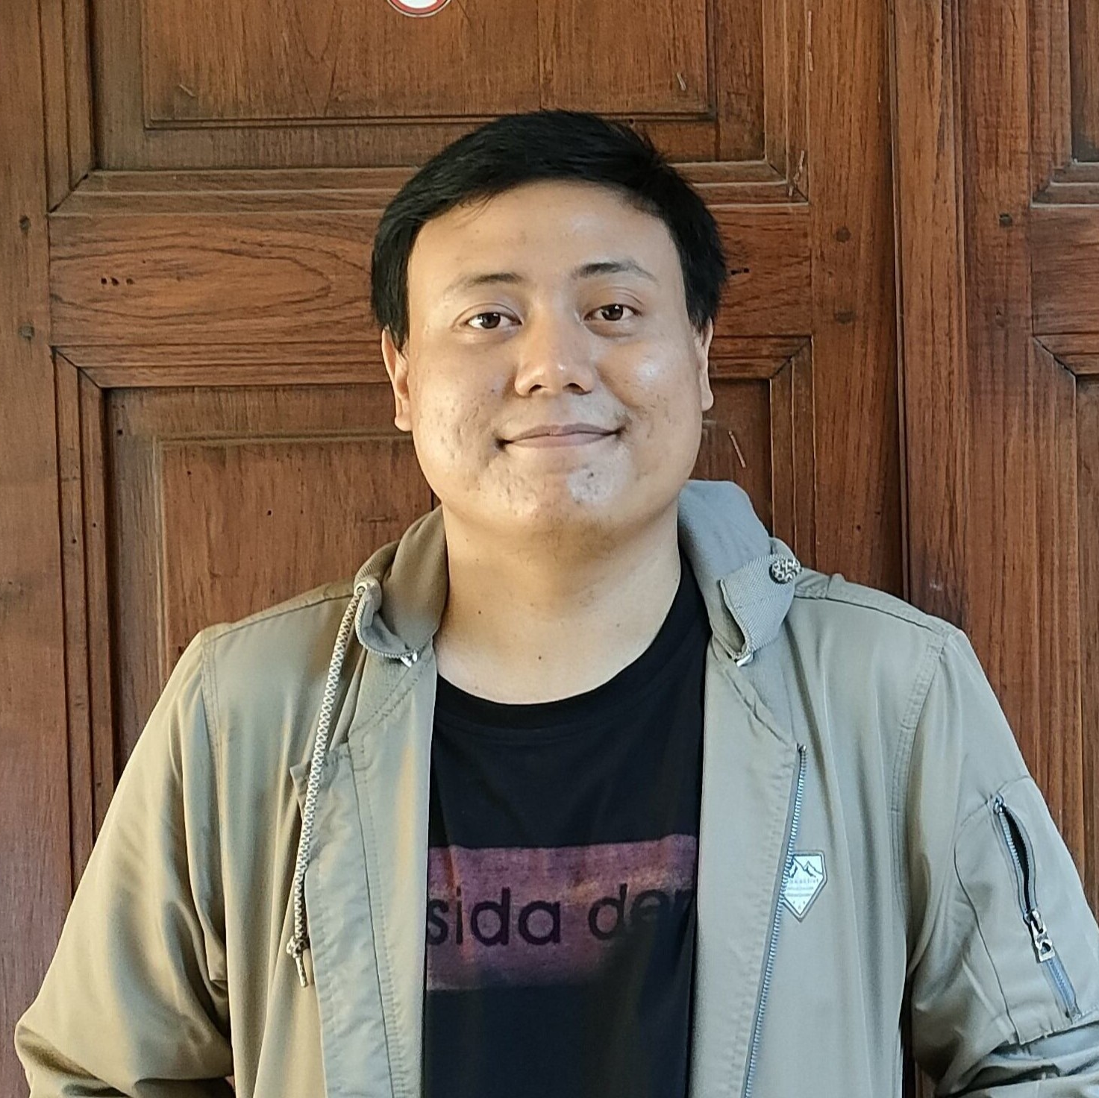
Predict Customer Personality to boost marketing campaign by using Machine Learning
Created by:
Muhammad Cikal Merdeka
Email : mcikalmerdeka@gmail.com
LinkedIn : linkedin.com/in/mcikalmerdeka
Github : github.com/mcikalmerdeka
Dedicated entry-level data scientist with analytical and experimental background of Physics. My graduation 2023, a pivotal year marked by significant advancements in artificial intelligence with the introduction of GPT-4 and other generative AI models, has fueled my curiosity and excitement to delve into the field of data. I have comprehensive grasp of data science methodology from business understanding to modelling process with proficiency in Python, SQL, Tableau, Power BI, Looker Studio and other tools related to data analytics workflow from several coursework and bootcamps.

Slide 2
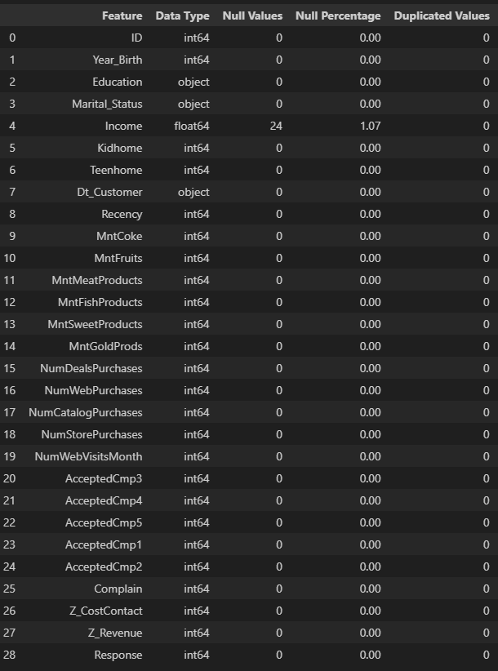
Data Cleaning & Preprocessing
Identifying Missing and Duplicated Values
Income column have a small percentage missing values, we will handle that by imputation with median values considering the positive skewed distribution of the values.
No duplicated values in this dataset.

Slide 3
Data Cleaning & Preprocessing
Feature Encoding
Income column have a small percentage missing values, we will handle that by imputation with median values considering the positive skewed distribution of the values.
No duplicated values in this dataset.

Slide 4
Data Cleaning & Preprocessing
Pada tahap cleaning data, tunjukan null atau missing value serta duplicated value pada dataset, serta cara penyelesaiannya.
Selanjutnya untuk data preprocessing, tunjukan bahwa data sudah dilakukan proses feature encoding dan feature standardisation.
Source code yang sudah kamu buat, dapat ditampilkan dan berikan link untuk mengakses file tersebut. Contohnya seperti di pojok kanan bawah.
Untuk selengkapnya, dapat melihat jupyter notebook disini

Slide 5
Feature Engineering
Create new columns based on the existing columns such as :
Age : calculating the age of each customer based on their birth year and current time.
Age_Group : grouping the `age` column into category based on the distribution
Num_Child : sum the values of Kidhome and Teenhome, representing the total number of dependents or children a customer has.
Membership_Duration : duration of customer membership in year.
Total_Acc_Camp : the total number of times each customer responded to the 5 campaigns that were conducted (AcceptedCmp 1 - 5).
Total_Spending : total purchase amount of each customer across all products.
Total_Purchases : the total purchase amount of each customer across all types of transactions.
CVR (Conversion Rate) : the ratio of Total_Purchases to the Number of Web Visits for each customer. It represents the percentage of website visitors who made purchases.

